Slide 1
Lecture 12 Graph Algorithms

Slide 2
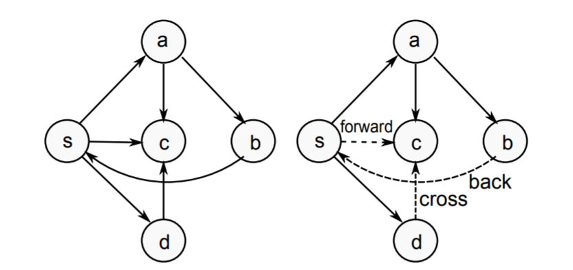
Type of Edges
Tree/Forward: pre(u) < pre(v) < post(v) < post(u)
Back: pre(v) < pre(u) < post(u) < post(v)
Cross: pre(v) < post(v) < pre(u) < post(u)

Slide 3
Application 1 – Cycle Finding
Given a directed graph G, find if there is a cycle in the graph.
What edge type causes a cycle?

Slide 4
Algorithm
DFS_cycle(u)
Mark u as visited
Mark u as in stack
FOR each edge (u, v)
IF v is in stack
(u,v) is a back edge, found a cycle
IF v is not visited
DFS_cycle(v)
Mark u as not in stack.
DFS
FOR u = 1 to n
DFS_cycle(u)

Slide 5
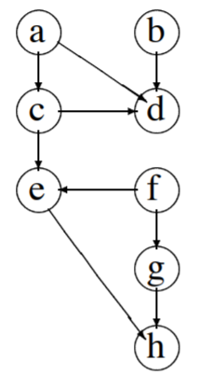
Application 2 – Topological Sort
Given a directed acyclic graph, want to output an ordering of vertices such that all edges are from an earlier vertex to a later vertex.
Idea: In a DFS, all the vertices that can be reached from u will be reached.
Examine pre-order and post-order
Pre: a c e h d b f g
Post: h e d c a b g f
Output the inverse of post-order!

Slide 6
Breadth First Search
Visit neighbor first (before neighbor’s neighbor).
BFS_visit(u)
Mark u as visited
Put u into a queue
WHILE queue is not empty
Let x be the head of the queue
FOR all edges (x, y)
IF y has not been visited THEN
add y to the queue
Mark y as visited
Remove x from the queue
BFS
FOR u = 1 to n
BFS_visit(u)

Slide 7
Breadth First Search Tree
IF y is added to the queue while examining x, then (x, y) is an edge in the BFS tree
1
1
2
3
2
3
4
4
5
5

Slide 8
BFS and Queue
BFS Order: The order that vertices enter (and exit) the queue
1
 | 2 | 3 | 4
 |  | 3 | 4 | 5
 |  |  | 4 | 5
 |  |  |  | 5
1
2
3
4
5

Slide 9
Application 1 – Shortest Path
Given a graph, vertices (u, v), find the path between (u, v) that minimizes the number of edges.
Claim: The BFS tree rooted at u contains shortest paths to all vertices reachable from u.

Slide 10
Applications 2 – Bipartite Graph
A graph is bipartite if it can be colored using two colors (say red and blue), such that every edge connects a red vertex and a blue vertex.
Given an undirected graph, decide whether it is bipartite, and give a coloring if it is bipartite.

